Slide 1
Azure Storage
Joe Losinski
Partner Technology Strategist

Slide 2
What will we accomplish?
Purpose of this workshop
Describe Azure Storage
Develop the foundational Azure Storage design

Slide 3
High-level agenda
Azure Storage overview
Storage offerings
Storage availability and redundancy
Storage performance
Storage management
Storage deployment models
Key decisions
Next steps

Slide 4
Storage overview

Slide 5
Azure Storage Services
IaaS
PaaS
Virtual machines
Existing frameworks
Web and mobile
Microservices
Serverless Compute
Storage
Networking
Disks
Persistent disks for Azure IaaS VMs
Standard Storage Disks:
Magnetic disk based, low IOPS, moderate latency
Premium Storage Disks: SSD based, high IOPS, low latency
Managed Disks
Files
Fully Managed File Shares in the Cloud
SMB and REST access
“Lift and shift” legacy apps
Blobs
Highly scalable, REST based cloud object store
Block Blobs: Sequential I/O, Hot, Cool and Archive Tiers
Page Blobs: Random-write pattern data
Append Blobs
Tables
Massive auto-scaling NoSQL store
Dynamic scaling based on load
Scale to PBs of table data
Fast key/value lookups
Queues
Reliable queues at scale for cloud services
Decouple and scale components
Message visibility timeout and update message to protect against unreliable dequeuers
Built on a unified Distributed Storage System
Durability, Encryption at Rest, Strongly Consistent Replication, Fault Tolerance, Auto Load-Balancing

Slide 6
What is the Blob Storage Service?
Azure’s Object Storage platform
Store and serve unstructured data
App and Web scale data
Backups and Archive
Big Data from IoT, Genomics, etc.
Types of Blobs
Block Blobs - Most object storage scenarios
Append Blobs - Multi-writer append only scenarios
Page Blobs - Page aligned random reads and writes
Image.jpg
Block 1
Block 2
Block 3
Block 4
512
1024
1536
2048
Sparse File
512 byte aligned
2560

Slide 7
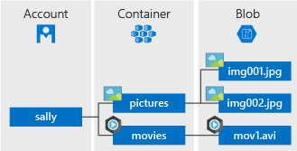

Azure Blob storage overview
Blob storage offers three types of resources:
Blobs
“Highly scalable, REST based cloud object store”
Blobs
Object storage
access via REST
Blobs
Designed for:
Serving images or documents directly to a browser.
Storing files for distributed access.
Streaming video and audio.
Writing to log files.
Storing data for backup and restore, disaster recovery, and archiving.
Storing data for analysis by an on-premises or Azure-hosted service.
Streaming & random object access scenarios

Slide 8
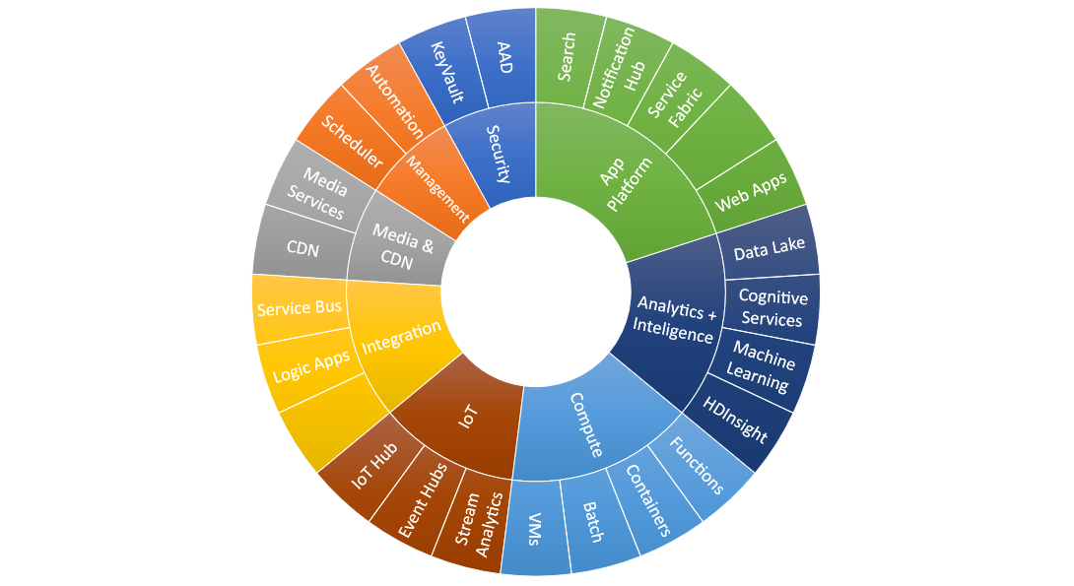
Azure Ecosystem and Blob Storage
Blob Storage
Broad integration for Blobs across Azure services

Slide 9
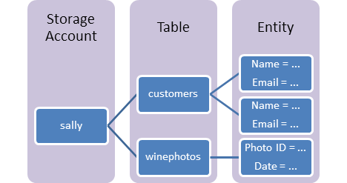

Azure Table Storage overview
Table storage contains the following components:
Tables
“Massive auto-scaling NoSQL store”
Tables
Tables
Azure Table storage is a service that stores structured NoSQL data in the cloud, providing a key/attribute store with a schemaless design.
You can use Table storage to store flexible datasets like user data for web applications, address books, device information, or other types of metadata your service requires. You can store any number of entities in a table, and a storage account may contain any number of tables, up to the capacity limit of the storage account.
NOSQL storage
access via REST
KeyValue Store

Slide 10
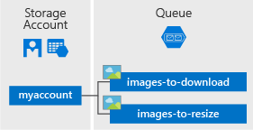

Azure Queues overview
Queue service contains the following components:
Queues
“Reliable messaging at scale for cloud services”
Queues
Queues
Azure Queue storage is a service for storing large numbers of messages that can be accessed from anywhere in the world via authenticated calls using HTTP or HTTPS.
Common uses of Queue storage include:
Creating a backlog of work to process asynchronously
Passing messages from an Azure web role to an Azure worker role
Reliable messaging
access via REST
Scheduling async tasks

Slide 11
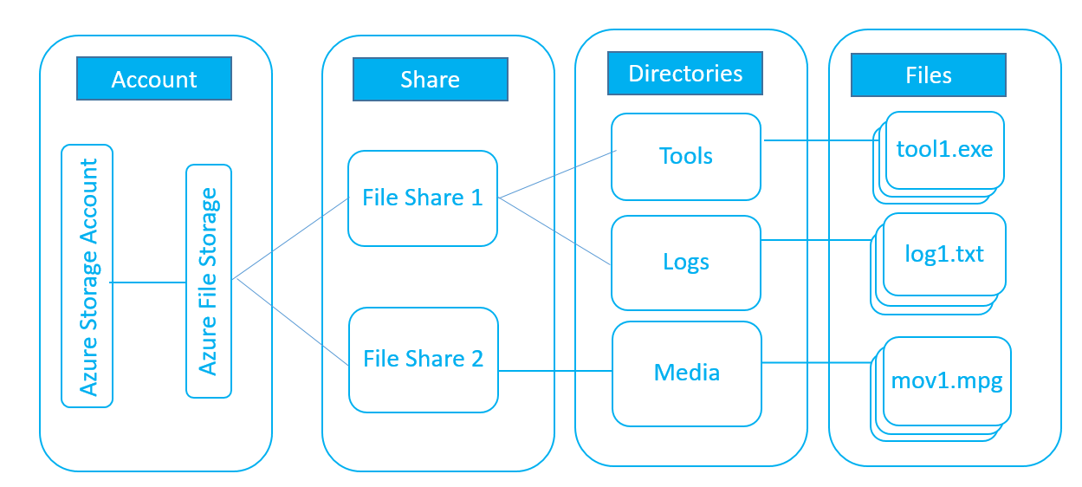
Azure Files overview
Azure Files management constructs:
Files
“SMB access to Azure Storage”
Files
Files
Azure Files offers fully managed file shares in the cloud that are accessible via the industry standard Server Message Block (SMB) protocol.
Replace or supplement on-premises file servers
Makes it easy to "lift and shift" applications to the cloud that expect a file share to store file application or user data
Natively supported by OS APIs, libraries, and tools
Built on SMB2.1, works with Windows and Linux
No limits on number of shares; 5TB and 1000 IOPS per share
File storage
access via SMB, REST
Lift-n-shift scenarios

Slide 12
Azure Disks
Performance tiers
Simplified management
Resource Group
Managed Disks Highly available and scalable
Premium SSD Disks Provisioned performance for Enterprise Prod
Standard SSD Disks Cost effective performance for entry-level workloads
Standard HDD Disks HDD based, cost effective for dev-test workloads
Industry leading ZERO% annual failure rate
Best in class VMs with
high IOPS/BW
< 1ms latency for cached operations
Developer support
Enterprise grade durability with 3 replicas
80,000 IOPS & 2,000 MB/s
Disk throughput per VM
Blob Cache technology
Up to 160,000 IOPS
REST API support
Easy migration/DR backup
Rich partner ecosystem
Notes:
Start with question:
- How many of you are using Azure Disks?
- How many of you are currently using Managed Disks?
How many of you are using Premium Disks?
What about Managed Premium Disks?
We have Disks offers based on the performance tiers:
Premium Disks, those are SSD based which provide high IOPS, throughput and consistent latency
Standard Disks using Magnetic drives which does not provide provisioned performance, however, this is a cost effective option for applications who do not require very high performance. This is ideal for test and dev workloads
We have recently introduced as a public Preview on June 4th - Azure Standard SSD Disks, a low-cost SSD offering, are optimized for test and entry-level production workloads requiring consistent latency. Standard SSD Disks can also be used for big data workloads that require high throughput. Standard SSDs deliver lower latency compared to Standard HDDs, while improving reliability and scalability for your applications, and are available with all Azure VM sizes.
Standard SSDs can be easily upgraded to Premium SSDs for more demanding and latency-sensitive enterprise workloads. Offered as a managed disk solution, Standard SSDs come with the same industry leading durability and availability that you expect from Azure Disks.
Lets look at Management options:
We recently launched Managed Disks which provide better manageability and support high availability deployment options. We have deep dive session on this topic so I am not going to spend too much time here.
We also have unmanaged disks, those are legacy disks. One of the unique capability is that we have REST support. You do not need to mount the disks to your VM to access the disks.

Slide 13
Object storage for every use case
Azure Blob
Hot
Cool
Archive
Frequently accessed data
Less frequently accessed data
Rarely accessed data
Per TB per month
$20.80
$15.20
$0.99
Per 10k write operations
$0.05
$0.10
$0.10
Retrieval times
Immediate
Immediate
Hours
Cloud native application data storage
Repository for server backups
Medical records archiving
Use cases
Notes:
Azure Object Storage provides secure, scalable, high-performing solutions for a broad spectrum of use cases
Azure object storage handles massive amounts of data; over 130 trillion objects to date
And it processes over 30 million transactions per second
Object storage is also designed to help protect customer data with encryption at rest as the default
We’ve recently brought Archive storage into public preview.
Archive is designed to handle data that is rarely accessed
and offers industry competitive pricing of only 18 cents per TB per month making the cloud an ideal place to handle your backup needs

Slide 14
Scalability & performance roadmap
 | Standard HDD Managed Disks | Standard SSD Managed Disks | Premium SSD Managed Disks
Disk latency | Double digit millisecond | Single digit millisecond | Uncached Read: ~4ms Uncached Write: ~2ms -> ~1ms (Q3 CY2018)
Max disk size | 4TB -> 32TB (H2 CY18) | 4TB -> 32TB (H2 CY18) | 4TB -> 32TB (H2 CY18)
Max disk IOPS | 500 IOPS | 500 IOPS | 7,500 IOPS
Max disk bandwidth | 60 MBps | 60 MBps | 250 MBps
* The disk performance target is subject to change
Notes:
Apart from the new features, larger, faster and more performant disks are what the customer will always look for.

Slide 15
Storage redundancy models
Zone 1
Zone 2
Zone 3
Typically >300mi
Typically >300mi
Async
Async
Primary
Secondary
Primary
Secondary
Locally-redundant storage (LRS)
3 replicas, 1 region
Protect against disk, node, rack failures
Write is ack’d when all replicas are committed
Superior to dual-parity RAID
Zone-redundant storage (ZRS) v2
3 replicas across 3 Zones
Protect against disk, node, rack and zone failures
Synchronous writes to all 3 zones
Geo-redundant storage (GRS)
6 replicas, 2 regions (3/region)
Protects against major regional disasters
Asynchronous to secondary
Read-access Geo-redundant storage (RA-GRS)
GRS + Read access to secondary
Separate secondary endpoint
RPO delay to secondary can be queried

Slide 16
Azure Zone Redundant Storage (ZRS)
Read / write resilience against single cluster / DC unavailability
Support for Blob, Table, File, Queue Storage
LRS
Resilient to disk/node/rack failures
ZRS
Resilient to single cluster / datacenter outage
GRS
Resilient to regional outage
RA-GRS
Resilient to regional outage
Read access to second region

Slide 17
Paired regions
Geography | Paired regions
Asia | East Asia | Southeast Asia
Australia | Australia East | Australia Southeast
Australia | Australia Central | Australia Central 2
Brazil | Brazil South | South Central US
Canada | Canada Central | Canada East
China | China North | China East
China | China North 2 | China East 2
Europe | North Europe | West Europe
France | France Central | France South
Germany | Germany Central | Germany Northeast
India | Central India | South India
India | West India | South India
Japan | Japan East | Japan West
Korea | Korea Central | Korea South
North America | East US | West US
North America | East US 2 | Central US
North America | North Central US | South Central US
North America | West US 2 | West Central US
UK | UK West | UK South
US Department of Defense | US DoD East | US DoD Central
US Government | US Gov Arizona | US Gov Texas
US Government | US Gov Iowa | US Gov Virginia
US Government | US Gov Virginia | US Gov Texas
https://docs.microsoft.com/en-us/azure/best-practices-availability-paired-regions

Slide 18
Types of storage accounts
Storage account type | Supported services | Supported performance tiers | Supported access tiers | Replication options | Deployment model | Encryption
General-purpose V2 | Blob, File, Queue, Table, and Disk | Standard, Premium | Hot, Cool, Archive | LRS, GRS, RA-GRS, ZRS, ZGRS (preview), RA-ZGRS (preview)⁴ | Resource Manager | Encrypted
General-purpose V1 | Blob, File, Queue, Table, and Disk | Standard, Premium | N/A | LRS, GRS, RA-GRS | Resource Manager, Classic | Encrypted
Block blob storage | Blob (block blobs and append blobs only) | Premium | N/A | LRS | Resource Manager | Encrypted
FileStorage | Files only | Premium | N/A | LRS | Resource Manager | Encrypted
Blob storage | Blob (block blobs and append blobs only) | Standard | Hot, Cool, Archive | LRS, GRS, RA-GRS | Resource Manager | Encrypted
Notes:
General-purpose v2 accounts: Basic storage account type for blobs, files, queues, and tables. Recommended
for most scenarios using Azure Storage.
General-purpose v2 accounts deliver the lowest per-gigabyte capacity prices for Azure Storage, as well as industry-competitive transaction prices. General
General-purpose v1 accounts: Legacy account type for blobs, files, queues, and tables. Use general-purpose
v2 accounts instead when possible.
To be used if → Your applications are transaction-intensive or use significant geo-replication bandwidth, but do not require large capacity.
In this case, general-purpose v1 may be the most economical choice.
Blob storage accounts: Blob-only storage accounts. Use general-purpose v2 accounts instead when possible
→All storage accounts are encrypted using Storage Service Encryption (SSE) for data at rest.
→ The Archive tier is available at level of an individual blob only, not at the storage account level. Only block blobs
and append blobs can be archived.
→ Zone-redundant storage (ZRS) is available only for standard general-purpose v2 storage 4 accounts.

Slide 19
Storage access control strategies
Multiple access control strategies
Storage account key – Full access
Shared access signature (SAS) – Token with configurable rights and time
Public – Blob storage only
Shared access signature
Resources – Account (coming soon), containers, Blobs, queues, tables, table ranges
Permissions – Read, write, delete, etc.
Time – Start time, end time
https://storageaccount.blob.core.windows.net/sascontainer?sv=2012-02-12&se=2013-04-13 T00%3A12%3A08Z& sr=c&sp=wl&
sig=t%2BbzU9%2B7ry4okULN9S0wst%2F8MCUhTjrHyV9rDNLSe8g%3Dsss
Notes:
You can grant access to the data in your storage account using any of the following approaches:
Azure Active Directory: Use Azure Active Directory (Azure AD) credentials to authenticate a user, group, or
other identity for access to blob and queue data (preview). If authentication of an identity is successful, then
Azure AD returns a token to use in authorizing the request to Azure Blob storage or Queue storage
Shared Key authorization: Use your storage account access key to construct a connection string that your
application uses at runtime to access Azure Storage. The values in the connection string are used to construct
the Authorization header that is passed to Azure Storage.
Shared access signature: Use a shared access signature to delegate access to resources in your storage
account, if you are not using Azure AD authentication. A shared access signature is a token that encapsulates all
of the information needed to authorize a request to Azure Storage on the URL. You can specify the storage
resource, the permissions granted, and the interval over which the permissions are valid as part of the shared
access signature.

Slide 20
Azure Files and Azure file Sync

Slide 21






What is Azure Files?
Cloud file shares that are…
Easily managed
Secure
No servers required
Data encrypted at rest and in transit
Cross-platform
Built for a hybrid world
Mount on Windows, Linux, and macOS
Protocols: SMB 2.1, 3.0, and REST
Access data where you want to,
how you want to
Smart
Harmonious
Make the most of limited networks
with intelligent caching
Migrate applications to the cloud
without the headaches

Slide 22


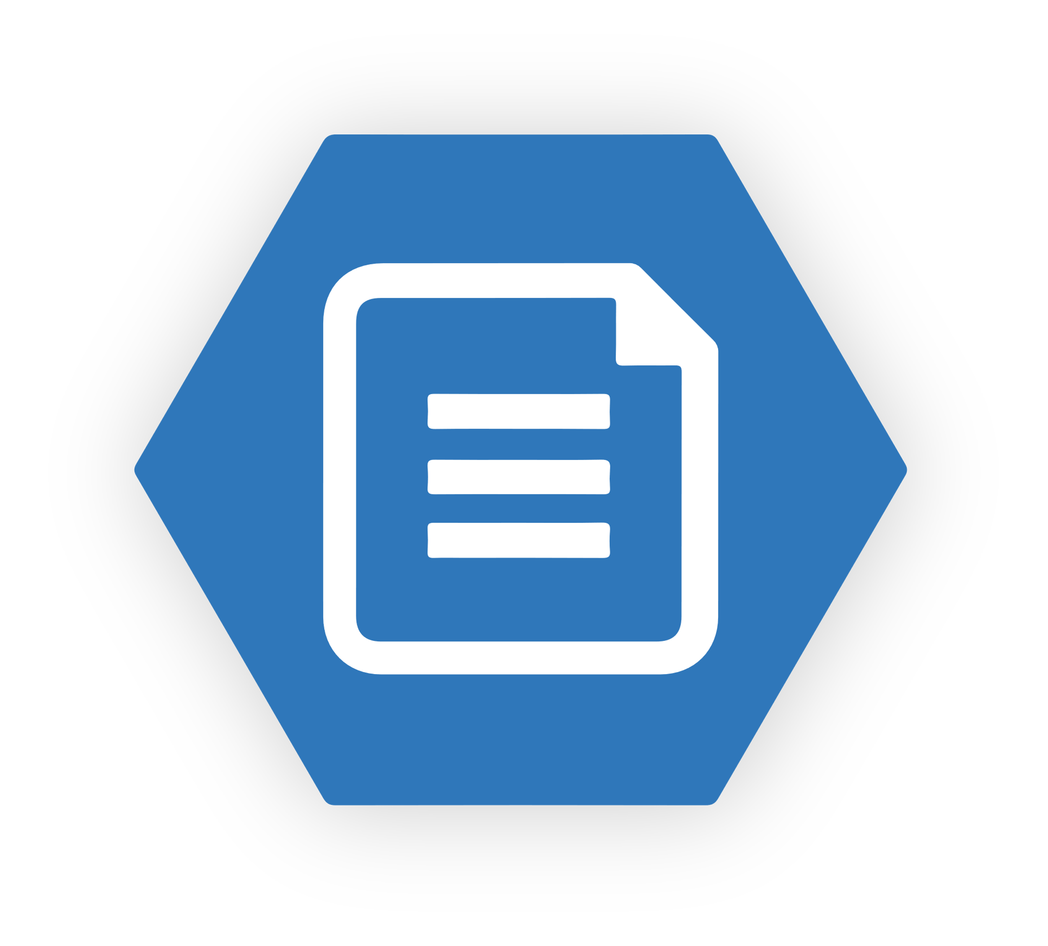
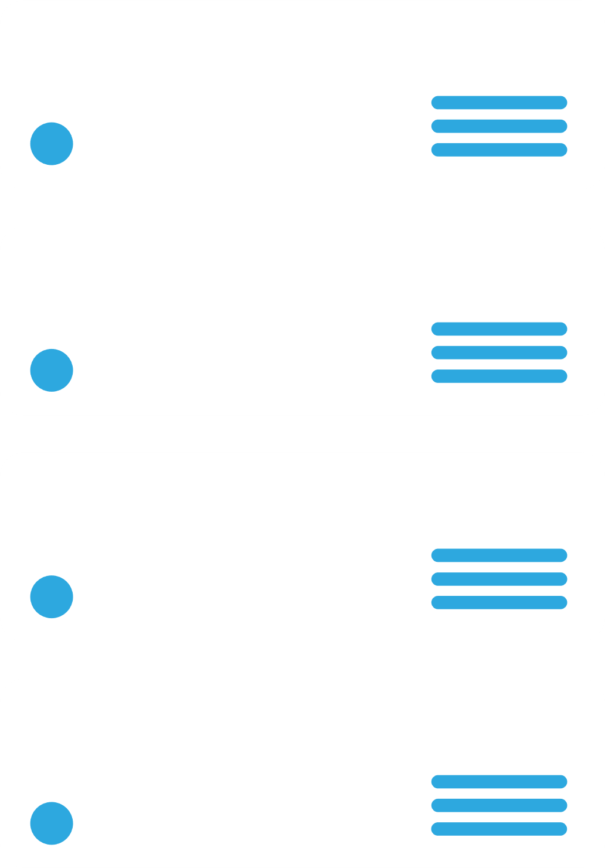






Azure File Sync
file sync
Centralize file services in Azure storage
file sync
Branch
file sync
Cache in multiple locations for fast, local performance
Utilize cloud-based backup and fast DR
Branch
Maintain on-prem compatibility
HQ Cluster
Notes:
Azure File Sync centralizes Windows file services into Azure Files reducing management complexity and cost.
Azure File Sync maintains compatibility and performance of existing on-premise file servers by turning them into lightweight, performance cache for Azure Files.
Specific Scenarios:
Multi-site access (same dataset across servers and Azure Files)
Cloud Tiering (cold data tiered from local Windows Server). Azure Files maintains a complete copy. Less frequently used data is removed from the on premise file server (the namespace is kept 100%)
Centralize File Services (Windows Server becomes on premise performance cache) in Azure
Cloud access (SMB 2.1 and 3.0 and REST access to data in Azure)
Integrated cloud backup and rapid file server DR. Very easy to quickly restore the namespace. The file contents come down in the background or quickly on access.
Move file services to Azure. Manage datasets centrally using Windows Server for local on premise cache given low latency/high speed access. Existing app & user access doesn’t change

Slide 23
Azure File Sync - Scenarios
Multi-site sync
Keep a data set in sync across multiple locations
Cloud tiering
Cloud tiering is an optional feature of Azure File Sync in which frequently accessed files are cached locally on the server while all other files are tiered to Azure Files based on policy settings. It turns a server into a lightweight, disposable, performance cache for Azure Files
Direct cloud access
Native file format with SMB and REST access
Integrated cloud backup
Point-in-time recovery and retention policies without redundant data transfer
Rapid file server DR
Fast namespace sync with no need to wait for data restore

Slide 24

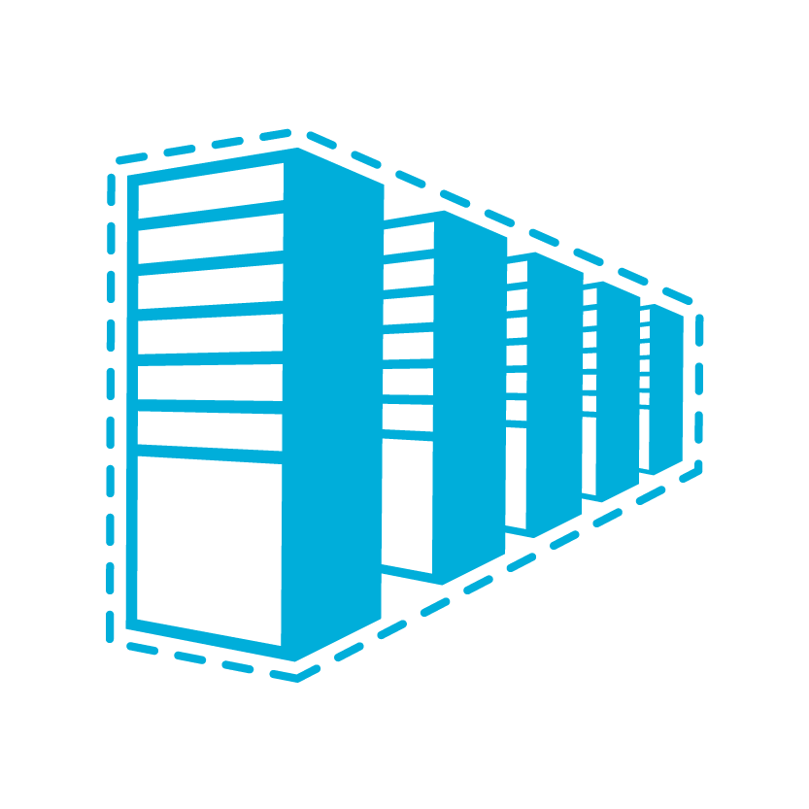


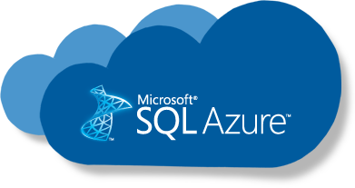
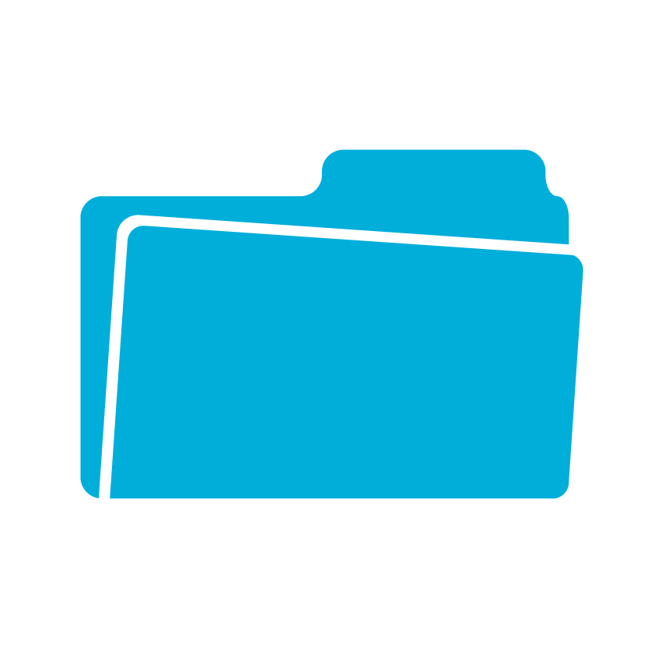

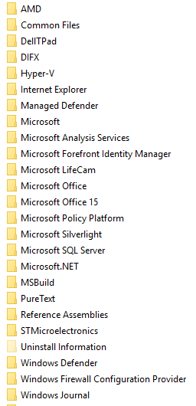

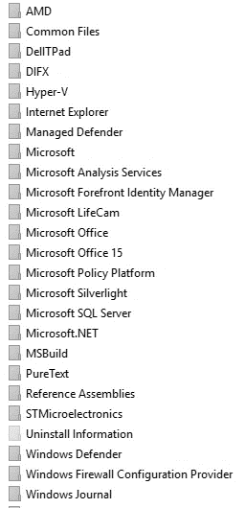

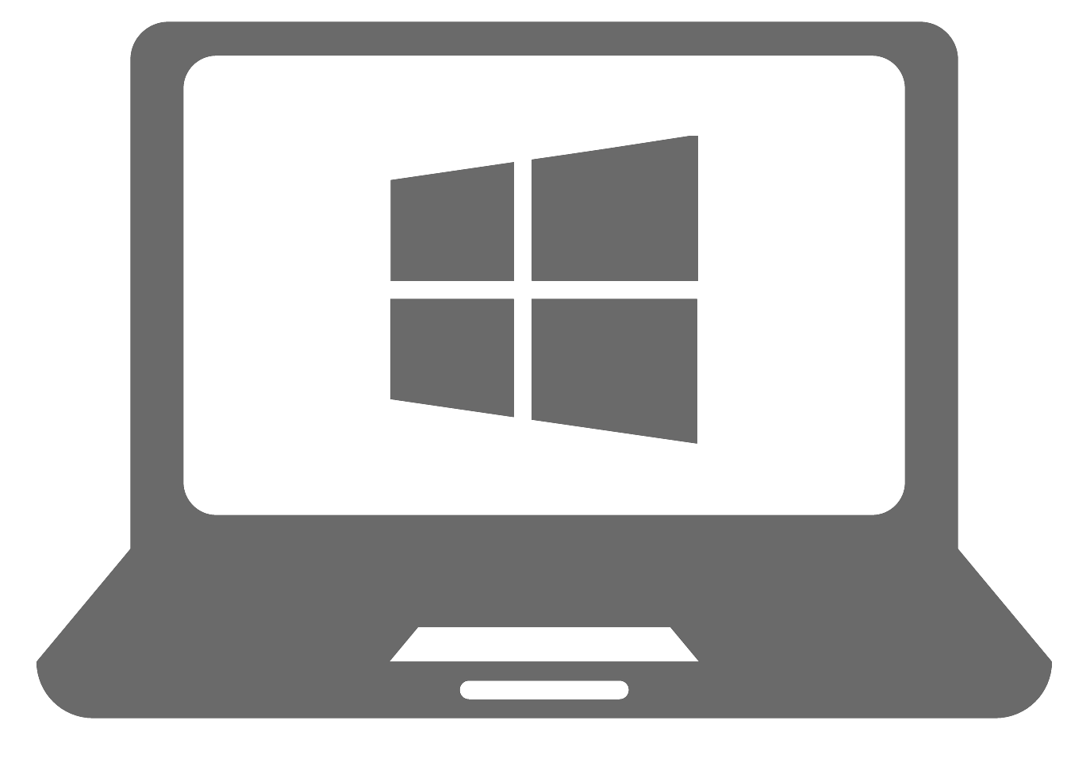
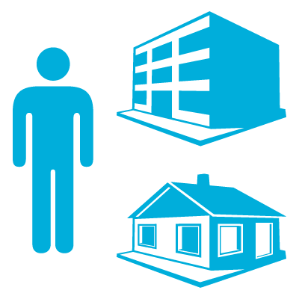


PaaS
IaaS
SMB
REST
West Europe
East US
Azure Backup Vault
File Share
File Share
File Share
File Share
AUTOMATIC FAIL OVER
Work Folders
SMB
NFS
Users
Applications
!
Branch Office Paris
Branch Office Seattle
Branch Office New York
Notes:
Existing on prem server out of space Traditionally 2 options: 1) Delete data 2) increase storage footprint
With Azure File Sync: third option: Sync the volume (or just a sub-folder) to it’s own Azure File Share. (A server can have many volumes or folders, each syncing with their own Azure File Share)
As these two locations are syncing, enable a feature called Cloud Tiering. CT allows the server to track access patterns to files and will ensure the most frequently accessed files stay cached locally, while the cold data can be displaced from the server. The entire namespace stays fully in-tact, thus allowing any user or application to see each file in the namespace. Any file access is as usual and the file will be served from local disk or from the Azure File Share (cold file)
Loose the local branch server Azure File Sync has a fast disaster recovery solution built-in:
Put in new server and connect to Sync Group (Could be totally different storage location than before – a server with no data on it)
Rapid server DR brings back namespace quickly. Users and application can start accessing the server already! – in most cases faster than restore from backup If a user or an application request to open a file, that file will be recalled from the cloud with priority! Once no more files are being requested, the server has time to act on it’s policies to fill the cache – can be interrupted at any time with a higher priority recall from a user/app
Replicate the same namespace/dataset to multiple servers in same region
Replicate to other Azure Files shares (cross region sync)
We call additional Azure File Shares that sync with another: Cloud Endpoints in the same Sync Group.
We call a location on a server that syncs with either of these Azure File Shares a Server Endpoint
Both C-EPs and S-EPs are fully read-write – changes made in one location travel to the others.
Add servers from other regions that strategically connect to the lowest network latency available Azure File Share (Branch-Office Paris server comes in at this point.)
Having more than 1 C-EP enables true High Availability of Azure File Storage. Servers that can for whatever reason not connect to one region, can automatically fail-over to the next (not in preview but actively being added)
All servers are essentially just normal file servers – so all the compatibility with existing LOB apps or features like smb/nfs/work folders/ etc. is provided – fully compatible.
Provide cloud access to the data (true hybrid – access on premise and the cloud)
Backup integration: Backup on-premises is a challenge when cloud tiering is used on a server: a backup application is likely attempting to recall all files locally if backup happens – defeats the purpose of CT. Better solution: Cloud Backup, in 2 steps:
Nearline Backup (available fall 2017): Snapshot based Azure File Share backups with all common restore options: Individual file / full share restore to original Az. File Share or alternative location. Pros: frequent snapshots possible (in most cases more often than on-prem), snapshots can be mounted as read-only SMB shares, self-service restore for users via previous versions. Downsides: Snapshots reside in production storage = not a long-term retention place and risky if accidental delete of storage account happens.
Backup-hardening (availability predicted for 2018) Latest snapshot is moved out of the storage account and stored in an Azure Backup/Recovery vault for long-term retention.

Slide 25
Managed Disks

Slide 26
Azure Managed Disks Benefits
Best value persistent storage for your business critical workloads
Secure by Default
Highly Available
Simple
Big Scale
Encryption at Rest
Granular RBAC
Prevents single points of failure due to storage
No operational costs for disk management
50,000 disks per region per subscription
No throttling due to storage account IOPS limits

Slide 27

Managed Disks Security
Managed Disks are Secure by Default
Managed disks provide granular Role-based Access Control for your disks
Storage Service Encryption by default
Azure Disk Encryption using your own keys

Slide 28


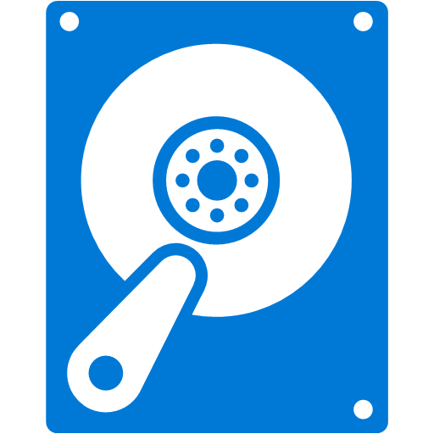
VM Availability with Unmanaged Disks
Availability Set
Azure Availability Sets protect Virtual Machines from compute related outages
Virtual Machines
FD0
FD1
FD2
☹
Unmanaged disks do not protect against single storage scale unit outages
Unmanaged Disks
Storage account 1
Storage account 2
Storage account 3
Storage Stamp 1

Slide 29
VM Availability with Managed Disks
Managed Availability Set
Managed Availability Sets protect Virtual Machines from compute related outages
Virtual Machines
FD0
FD1
FD2
☺
Managed disks protect against single storage scale unit outages
Managed Disks
Managed Storage account 1
Managed Storage account 2
Managed Storage account 3
Storage Stamp 0
Storage Stamp 1
Storage Stamp 2

Slide 30


Reusable Custom Images across subscriptions
Subscription 1
Subscription 2
Create VMs
Capture a VM
Create VMs
Create Image
Create VMs
Subscription 3
VHD files
Storage account

Slide 31
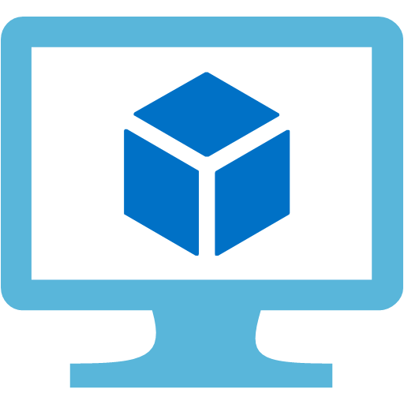


Unmanaged – Complex upgrade from Standard to Premium
Step 2
Delete existing VM & create a new VM
☹ Destructive process
Step 1
Copy VHD to Premium storage account
☹ ~ 24 hours downtime
Standard Storage account
Premium Storage account

Slide 32



Managed – Easy upgrade from Standard to Premium
Stop the VM
Update Storage to Premium
Restart
☺< 5 minutes downtime
☺Downtime only for reboot
☺No manual data copy
☺Single click upgrade
Standard Managed Disks
Premium Managed Disks
Notes:
Talking point:
Easily switch between Premium to Standard to save cost for the following scenarios:
For big events such as black Friday you need better and consistent performance and want to switch to Premium; switch back to Standard after the event
You want to start with Standard for proof of concepts, Dev/Test phase and then upgrade to Premium in the production environment
While transition between Standard-to-Premium and Premium-to-Standard tiers is supported, it is not recommended to transition workload disks between tiers at a high velocity (to manage costs or otherwise transition tiers)

Slide 33

Data at the edge Moving data from the edge into Azure with the Data Box family
Notes:
For partner presentations: Use this slide to replace the customer title slide.

Slide 34

Azure Data Box: how it works
4
You return Data Box
5
We upload
3
2
We confirm
You fill
We send Data Box
1
You order
Your Data Center
Azure Data Center

Slide 35
Data at the edge
Data Box online appliances empower cloud data management
SCENARIOS
Backup
Archive
Workload migration
Big data
Media and entertainment
Autonomous vehicles
Notes:
The current state of data:
Massive data exists outside the cloud, growing rapidly
Existing data: from workloads, backups, archive, media, etc.
New data: is being generated at exponential rates by new devices and in unique locations
Maintaining datacenter data: time-consuming & costly
Market requirement: simplify data movement to cloud
Range of online and offline methods to move data
Pre-process data before uploading to cloud to Aggregate, Modify, or Subset data
Machine-learning inferencing close for quick results
The cloud provides compute, analytics, and long-term storage of data at cloud scale

Slide 36
Data Box offline device selection
Data qty | 45 Mbps (T3) | 100 Mbps | 1 Gbps | 10 Gbps
1 TB | 2 days | 1 day | 2 hours | 14 minutes
10 TB | 22 days | 10 days | 1 day | 2 hours
35 TB | 76 days | 34 days | 3 days | 8 hours
80 TB | 173 days | 78 days | 8 days | 19 hours
100 TB | 216 days | 97 days | 10 days | 1 day
200 TB | 1 years | 194 days | 19 days | 2 days
500 TB | 3 years | 1 years | 49 days | 5 days
1 PB | 6 years | 3 years | 97 days | 10 days
2 PB | 12 years | 5 years | 194 days | 19 days
Key
Use the network
Use Data Box Disk
Use Data Box
Use Data Box Heavy
Use a Data Box when data volume exceeds network capacity
Note: the table is based on 100% available network bandwidth
Notes:
This slide is a drill-down to show the time it takes to move large quantities of data over various-speed networks. Here you can also describe the disk Import/Export option to the customer.

Slide 37

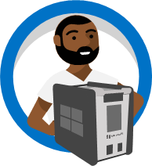
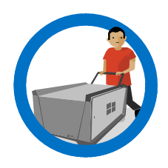
Azure Data Box: offline transfer options
Available for small, medium, or large migrations
PRODUCTS
CAPACITY
DESCRIPTION
Data Box Disk
8 TB, up to 40 TB
USB 3.1 SSD disks
Order up to 5 in each pack
Data Box
100 TB
Ruggedized, self-contained appliances
Data Box Heavy
1 PB

Slide 38
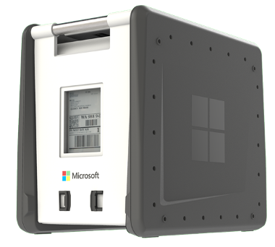
Azure Data Box
Fast and easy
Azure Data Box has 100TB of capacity, uses standard NAS protocols and common copy tools like Robocopy
Safe and secure
Azure Data Box is tamper-resistant and ruggedized for shipping. Data is protected with AES 256-bit encryption for safe transit
Partner supported
Azure Data Box is integrated with a global array of industry-leading Azure partners
Availability: GA – US, EU, UK, AUS, CA, JP
Coming soon – US Gov
Notes:
The current state of data:
Massive data exists outside the cloud, growing rapidly
Existing data: from workloads, backups, archive, media, etc.
New data: is being generated at exponential rates by new devices and in unique locations
Maintaining datacenter data: time-consuming & costly
Market requirement: simplify data movement to cloud
Range of online and offline methods to move data
Pre-process data before uploading to cloud to Aggregate, Modify, or Subset data
Machine-learning inferencing close for quick results
The cloud provides compute, analytics, and long-term storage of data at cloud scale

Slide 39
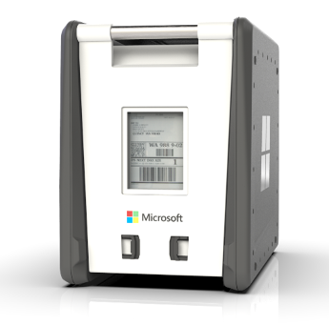
Data Box—technical summary
Specification | Details
Storage capacity | 100TB raw/~80TB usable
Data protection/security | AES 256-bit BitLocker encryption
Weight | ~50 lbs/20 kg
Network interface | 1x1/10 GbE RJ45 for management 1x1/10 GbE RJ45 and 2x10GbE SFP+ for data transfer
Access protocol | SMB/CIFS and NFS Azure Blob storage via REST API
Supported Azure storage types | Block Blob, Page Blob, Azure files and Managed Disk
Physical security | Tamper-evident ruggedized device casing
Power | 110/240 (50/60 Hz)
Dimensions | 17” H x 20” D x 12.2” W 43 cm x 51 cm x 31cm

Slide 40
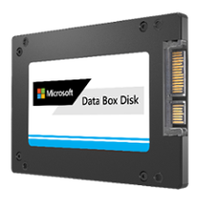
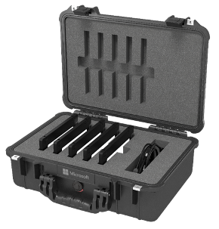
Azure Data Box Disk GA
Simple to order and use
You can easily order a pack(s) of up to five disks from the Azure portal for a total capacity of 40 TB per order.
Each 8 TB SSD provides the right balance of capacity and portability to collect and transport data in a variety of use cases. Support is available for Windows and Linux.
Fast data transfer
These disks copy data at up to USB 3.1 speeds and support SATA II and III interfaces.
Simply mount the disks as drives and use any tool of choice such as Robocopy, or just drag-and-drop to copy files to the disks.
Security
Disks are encrypted using AES 128-bit encryption and can be locked using custom passkeys.
After data upload, disks are wiped clean in accordance with NIST 800-88r1 standard
Generally Available in the US, EU, CA, AUS
Coming soon – JP, KR, US Gov
Notes:
The current state of data:
Massive data exists outside the cloud, growing rapidly
Existing data: from workloads, backups, archive, media, etc.
New data: is being generated at exponential rates by new devices and in unique locations
Maintaining datacenter data: time-consuming & costly
Market requirement: simplify data movement to cloud
Range of online and offline methods to move data
Pre-process data before uploading to cloud to Aggregate, Modify, or Subset data
Machine-learning inferencing close for quick results
The cloud provides compute, analytics, and long-term storage of data at cloud scale

Slide 41
Data Box Disk—technical summary
Specification | Details
Storage capacity | 8TB raw/7 TB useable; up to five disks per order for 40TB raw/35TB useable total capacity
Data protection/security | AES 128-bit encryption & NIST 800-88r1 sanitization
Device connection | USB 3.1, SATA II or III
Media | 2.5” Solid State Drive (SSD)
Supported OS | Windows (7,8,10), Windows Server (2008, 2012, 2016) Linux: CentOS 6.9+, RHEL 6.9+, Ubuntu 14+, Debian 8+
Supported Azure storage types* | Block Blob, Page Blob, Azure Files and Managed Disk
Power | No external power required
Dimensions (h/w/d) | Each - 0.4” x 2.8” x 4”
* Currently valid for GPv1, GPv2 and Blob storage accounts

Slide 42
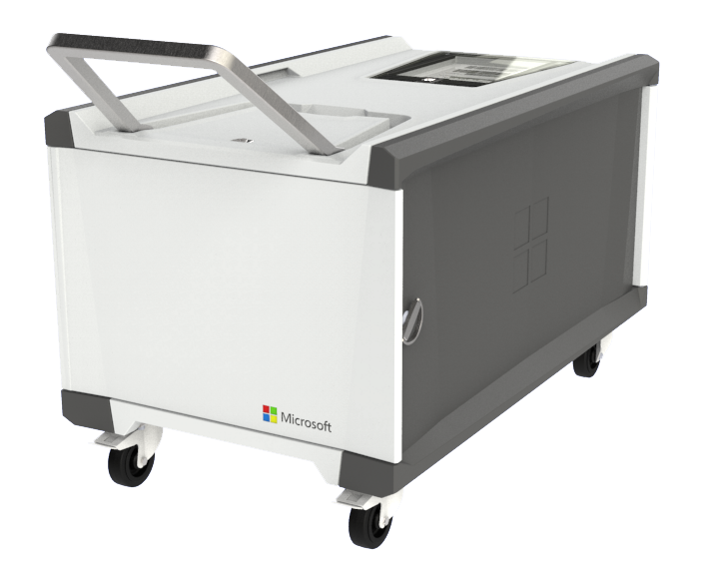
Azure Data Box Heavy
Lift massive data payloads into the cloud
Simple to order and use
Order Data Box Heavy from the Azure portal. It will be shipped via truck directly to your DC. For simplicity, it uses common copy tools like Robocopy
Large capacity
Data Box Heavy lifts massive data payloads to Azure with its 1 PB data capacity
Safe and secure
Data Box Heavy is tamper-resistant and ruggedized for shipping. Data is protected via AES 256-bit encryption for safe transit
Available – US, EU, UK
Coming soon – CA, AUS, US Gov, JP
Notes:
The current state of data:
Massive data exists outside the cloud, growing rapidly
Existing data: from workloads, backups, archive, media, etc.
New data: is being generated at exponential rates by new devices and in unique locations
Maintaining datacenter data: time-consuming & costly
Market requirement: simplify data movement to cloud
Range of online and offline methods to move data
Pre-process data before uploading to cloud to Aggregate, Modify, or Subset data
Machine-learning inferencing close for quick results
The cloud provides compute, analytics, and long-term storage of data at cloud scale

Slide 43
Data Box Heavy—technical summary
Specification | Details
Storage capacity | 1 PB raw/~800TB usable
Data protection/security | AES 256-bit BitLocker encryption
Weight | <500 lbs/227 kg
Network interface | 2x1/10GbE RJ45 for management 4x40GbE QSFP+ for data transfer
Access protocol | SMB/CIFS and NFS Azure Blob Storage via the REST API
Supported Azure storage types | Block Blob, Page Blob, Azure Files and Managed Disk
Physical security | Tamper-evident ruggedized device casing
Power | 110/240 (50/60 Hz)
Dimensions | 27”H x 44”D x 26“W 69cm x 112cm x 66cm

Slide 44
Data Box pricing for offline solutions
 | Data Box |  | Data Box Disk |  | Data Box Heavy
Location | US | EU¹ | US | EU¹ | US | EU¹
Import service fee/ order processing fee | $250 | €215 | $50 | €42 | $4,000 | €1336
Daily Disk usage fee² |  |  | $10 | €8.5
Extra day fee | $15/day | €12/day |  |  | $100 | €43
Device shipping | $95 | €95 | $30 | €30 | ~$1,500³ | ~€1,500³
Euro prices based on current exchange rates and may vary
Daily Disk usage fee includes first three days as a grace period
Starting shipping price. May be higher depending on carrier, and shipping options
Data Box pricing currently in effect

Slide 45
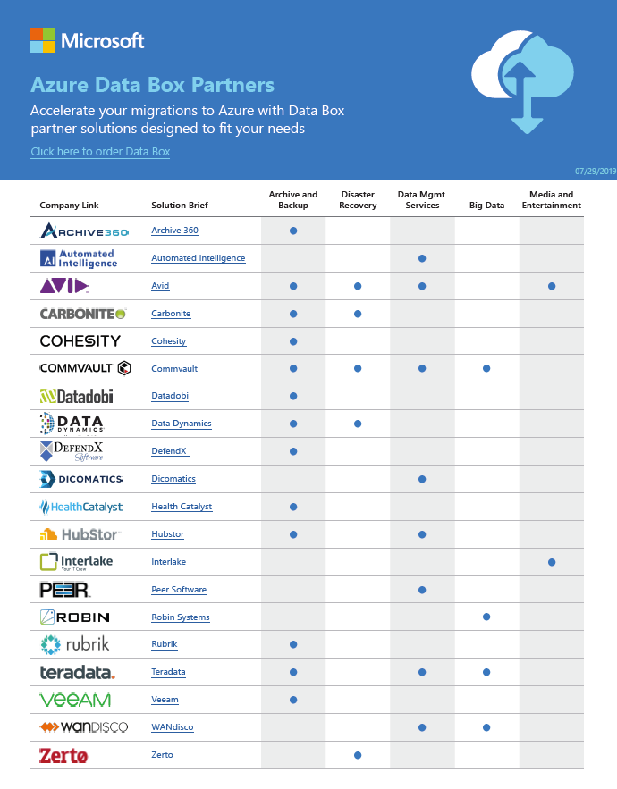
Data Box partners: more benefits
The Azure Data Box partner page
Validated solution partners can publish Data Box solutions, including a short value prop statement
Publish links to your product details, solution briefs
https://aka.ms/databoxpartners

Slide 46
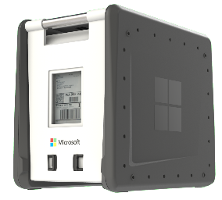
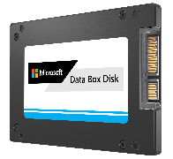
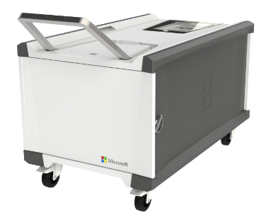
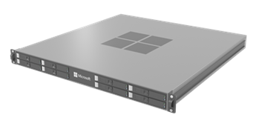





Azure Data Box family—summary
OFFLINE DATA TRANSFER
ONLINE DATA TRANSFER
Data Box
Capacity: 100 TB
Weight: ~50 lbs.
Secure, ruggedized appliance
GA
Data Box enables bulk migration to Azure when network isn’t an option
Data Box Disk
Capacity: 8TB ea.; 40TB/order
Secure, ruggedized USB drives orderable in packs of 5 (up to 40TB)
GA
Perfect for projects that require a smaller form factor e.g., autonomous vehicles
Data Box Heavy
Capacity: 1 PB
Weight 500+ lbs.
Secure, ruggedized appliance
GA
Same service as Data Box, but targeted to petabyte-sized datasets
Data Box Gateway
Virtual device provisioned in your hypervisor
Supports storage gateway, SMB, NFS, Azure blob, files
GA
Virtual network transfer appliance (VM), runs on your choice of hardware
Data Box Edge
Local Cache Capacity: ~12 TB
Includes Data Box Gateway and Azure IoT Edge
GA
Data Box Edge manages uploads to Azure and can pre-process data prior to upload
Network Data Transfer
Edge Compute
ORDER
SEND
FILL
RETURN
UPLOAD
CLOUD TO EDGE
EDGE TO CLOUD
PRE-PROCESSING
ML INFERENCING

Slide 47
Tools and Best Practices

Slide 48



Realize the benefits by eliminating operational costs associated with Unmanaged Disks
Costs associated with Unmanaged Disks may include
Performance optimization
Subscription Planning
Configuration Management
Unplanned
Downtime
Scalability Planning
Oversubscription of storage
Security Configuration
Rebalancing workloads

Slide 49
Billing Models for Persistent Disks
Used by:
Azure Premium Unmanaged Disks
Azure Premium Managed Disks
Azure Standard Managed Disks
Other Cloud Platforms
Provisioned Size
Cost Model
Provisioned Size per GB
Free Space
Used Size per GB
Consumed Size
Cost Model
Used by:
Azure Standard Unmanaged Disks

Slide 50
Disks - Best Practices
Always use Premium Disks for Production workloads
RAID for redundancy is not necessary
RAID for performance as needed
Durability doesn’t remove the need for backups
Performance
Local ssd is definitely temporary, use if you can tolerate loss
Enable read caching where appropriate for better performance
Understand VM limits vs Disk limits for performance

Slide 51
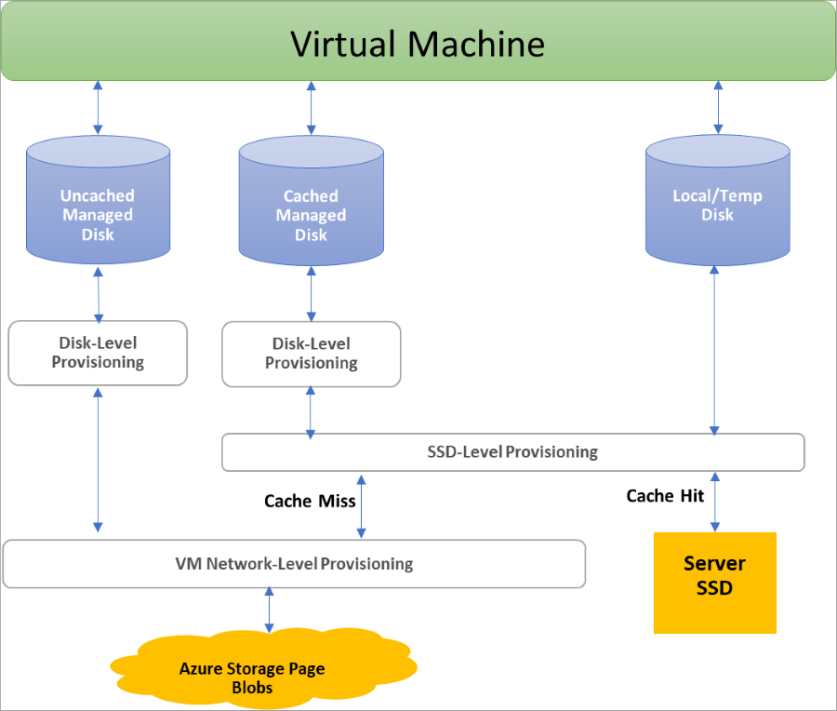

Disk Allocation and Performance

Slide 52

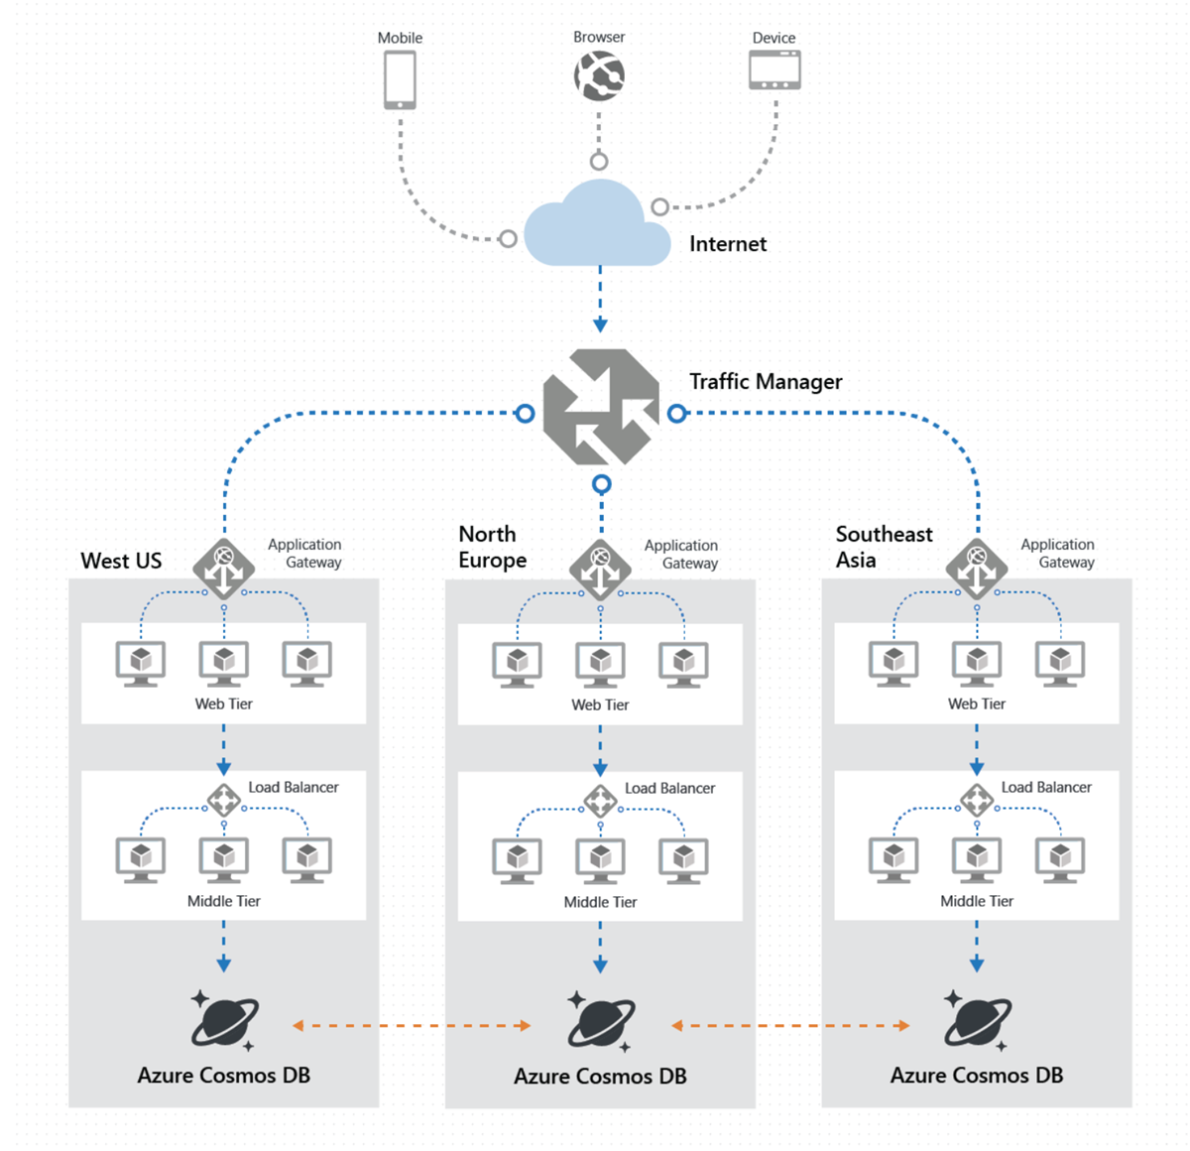

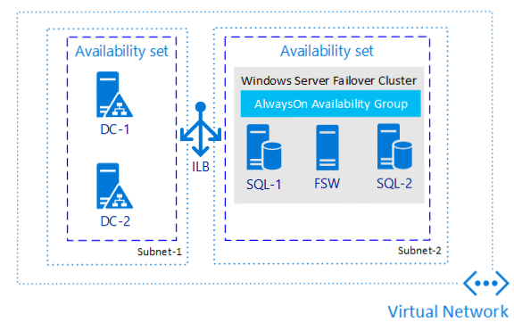
Global Distribution vs BCDR
RA-GRS is not Global Read/Write

Slide 53
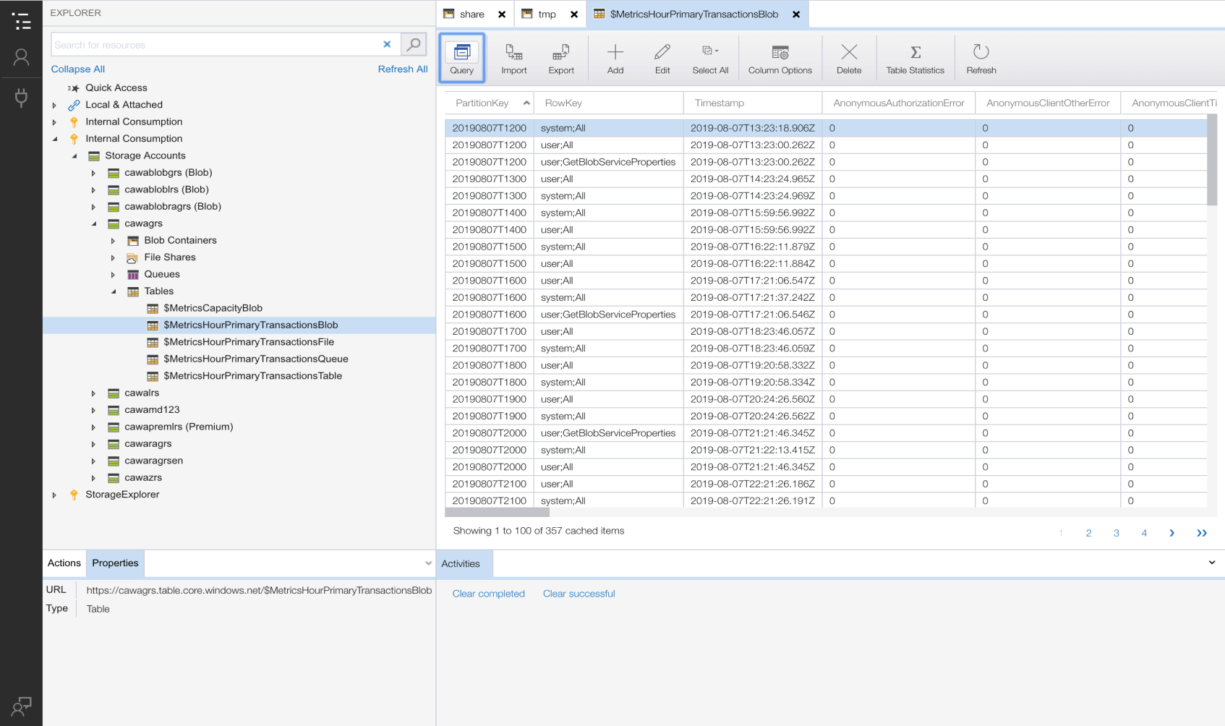
Azure Storage Explorer
Easy Storage Management
Create, delete, view, and edit resources in Azure Storage, Azure Cosmos DB, and Data Lake Storage.
Powerful Experience
Seamlessly view, search, and interact with your data and resources
Online or Off
Work disconnected from the cloud or offline with local emulators
Secure
Use the full range of Azure security features, including role-based access control, Azure Active Directory, and connection strings, to connect and manage your Azure resources—always over HTTPS

Slide 54
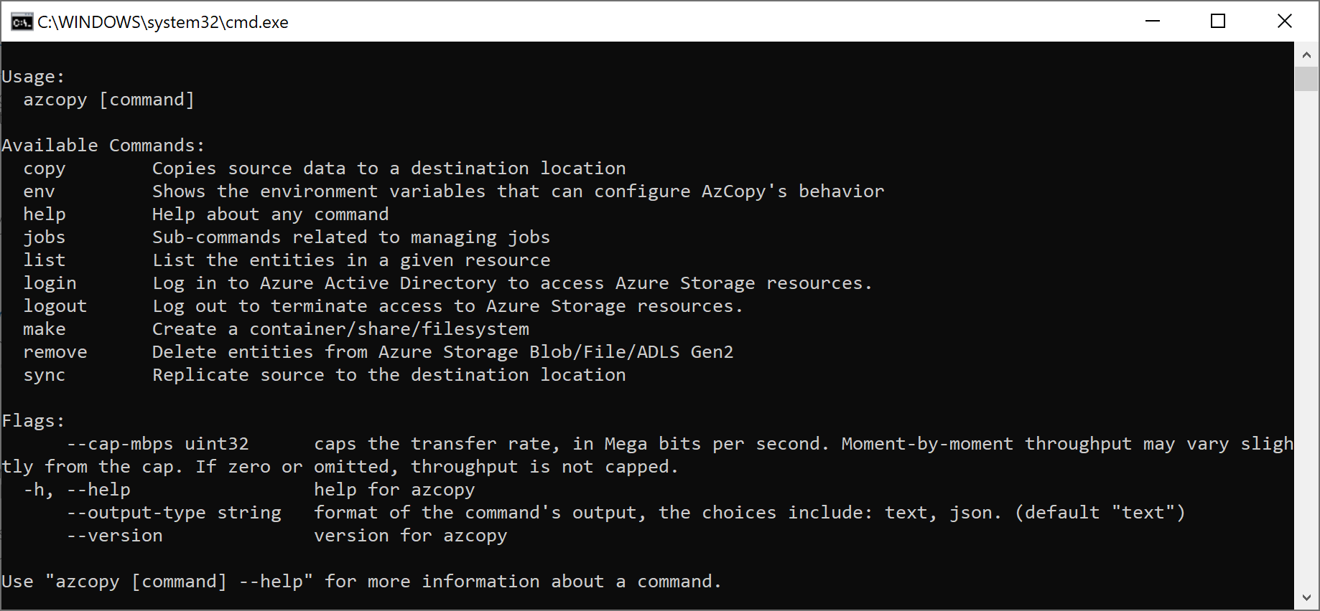
AZCopy
AKA.MS/AZCopy

Slide 55
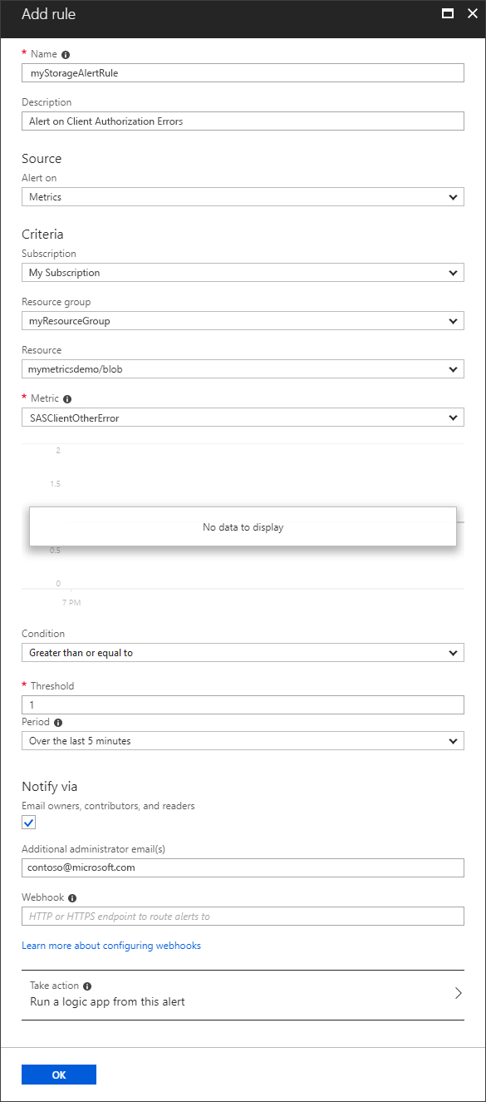
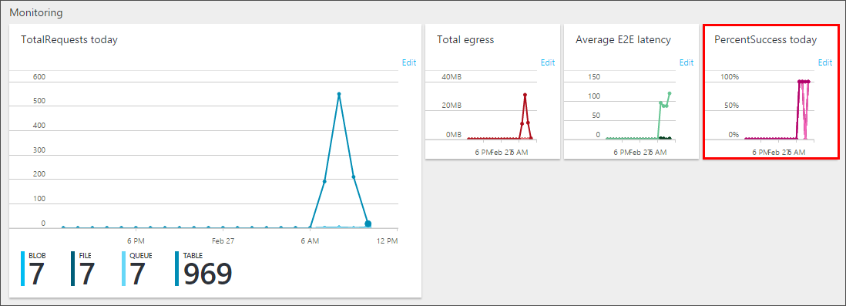
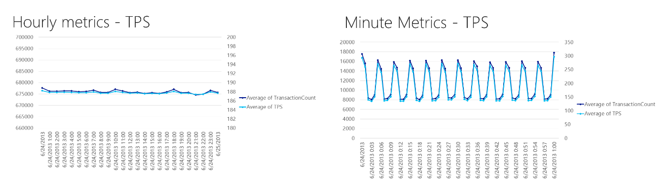
Monitoring

